Slide 1
ED group project Zap! (E-COMMERCE)
Entrepreneurship Development (2HS309)

Slide 2
team members
Krupal Patel – 20162121007 (BDA)
Ujjval Patel - 20162121021 (BDA)
Nitin Prajapati – 20162121022 (BDA)
Yash Prajapati -20162121023 (BDA)
Jinay Shah - 20162121025 (BDA)
Purav Shah - 20162121026 (BDA)
Rudra Patel – D2D (CBA)
Anuj Jani - D2D (CBA)

Slide 3
40 ideas using tools & techniques of ideation
Brainstorming:
Improving user interface so that user feels comfortable on website
There are problems related payment so we included payment gateway so that online payment as well as cash on delivery can also be done
Return policy is made flexible for users
Fast delivery
Discount
Free shipping anywhere in the world became possible through raised funding

Slide 4
Brainstorming :
we sell only trusted brand product.
Scratch & Win for customer benefits like Cashbacks / lucky draw
Exclusive Discounts (on festivals )
Delicate items are delivered carefully
Privacy is maintained
Authentic products are available

Slide 5
Brainstorming:
Custom delivery timings according to users choice
App and website are synchronized
Many e commerce shopping apps is not supported on all phones but or app is supported on every phone
Customer can contact to delivery man regarding any query in delivery

Slide 6
Divergent Thinking:
Language barrier problem solved by adding all native languages
Slow loading in website is a problem so that we have also launched or mobile application
Responsive website and mobile application
Member Loyalty Programs
Subscription Programs
Promote Made in India

Slide 7
Divergent Thinking:
Filter according to product type,price etc.
Exchange offer on products
Any seller can sell his/her products using our website as a medium
Selling of Second Hand Products is also available
Our website consist of negligible number of adds so that user doesn’t get annoyed
App takes very less time to start

Slide 8
Lateral Thinking (SCAMPER):
Modification are done so that low bandwidth problems are solved(Tool used:M – MODIFY/MAGNIFY)
Delivery issues solved (Tool used:R – REVERSE/REARANGE)
Image loading speed increased (Tool used:S – SUBSTITUTE)
Improved customer service (Tool used:S – SUBSTITUTE)
Improved customer support (Tool used:S – SUBSTITUTE)
Live Order Tracking is available (Tool used:A – ADAPT)

Slide 9
Lateral Thinking (SCAMPER):
Updated Refunding policy (Tool used:M – MODIFY/MAGNIFY)
Products are kept updated (Tool used:P – PURPOSE)
New Products are available as soon as they are available
(Tool used:A ADAPT)
Delivery during crises are also available which is faster in comparison to other e commerce websites (Tool used:A – ADAPT)
Special discount is offered to students if shopping is done through institute email id (Tool used:P – PURPOSE)

Slide 10
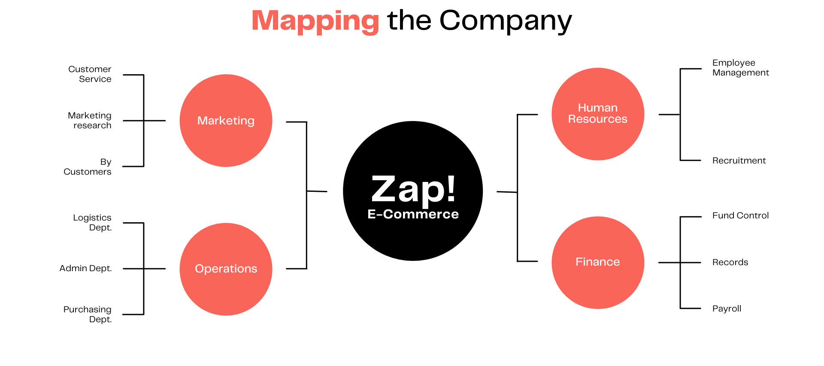
Mind-Map

Slide 11
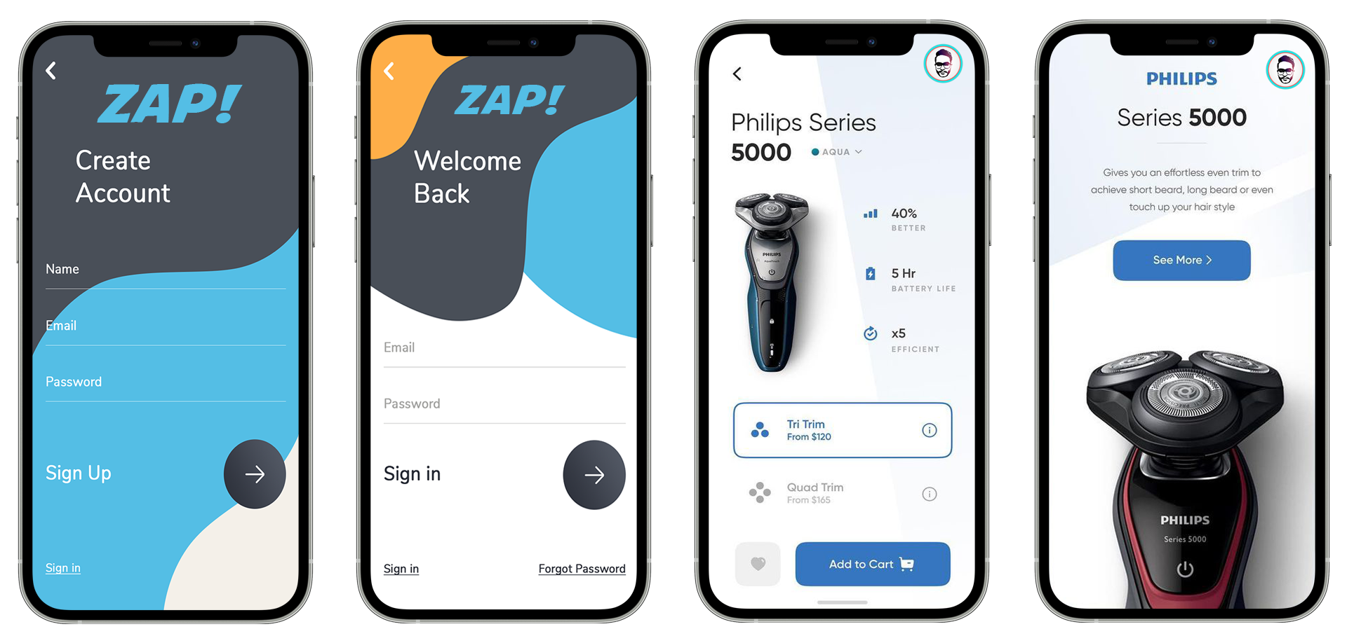
Prototype - 1

Slide 12
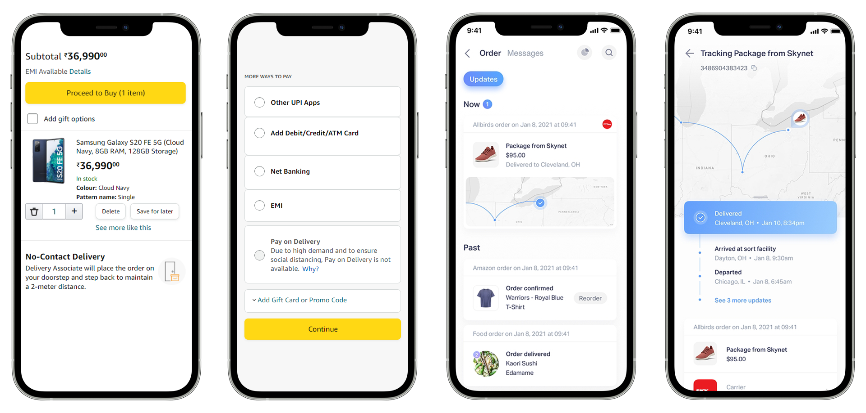
Prototype - 2

Slide 13
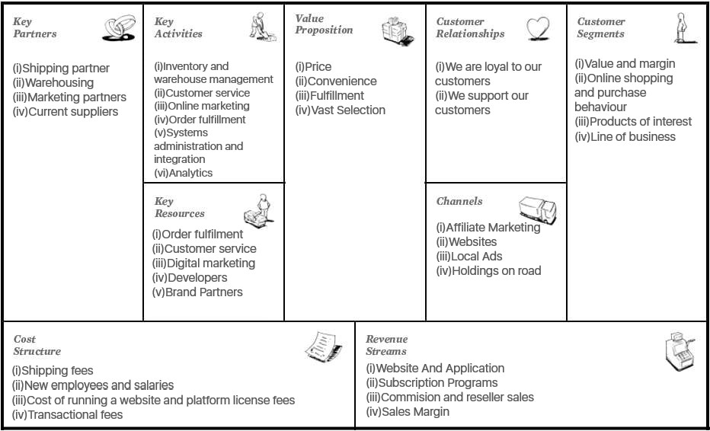
Business Model CANVAS

Slide 14
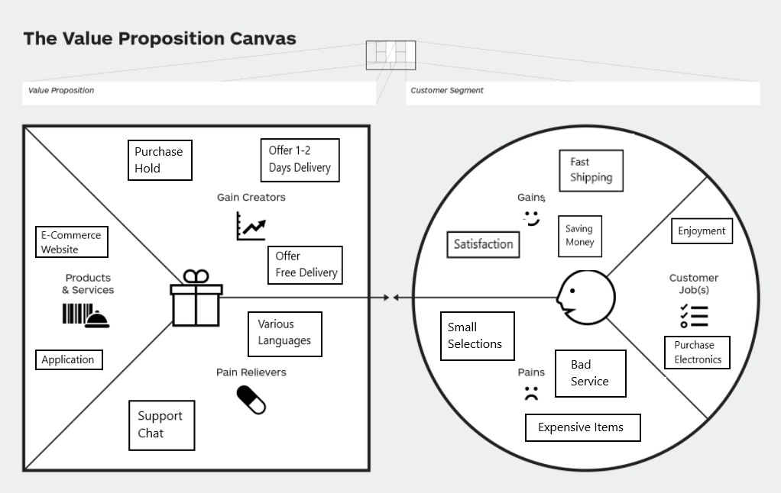
Value proposition CANVAS

Slide 15
thank you !!

